Slide 1

Student Details
Name : PaSUPULETI MAITREYA UDAY DURGA MAKHISH
Skillsbuild email id : pasupuletimaitreya@gmail.com
College name : Satya institute of technology
and management
College state : Andhra Pradesh
Internship domain : artificial intelligence
Internship start date : 13/06/2024
Internship end date : 25/07/2024

Slide 2
PROJECT TITLE
EMPLOYEES BURNOUT ANALYSIS AND PREDICTION
Presented by : P.Maitreya
Date :12-07-2004

Slide 3
AGENDA
Project Overview
End Users
Solution and Value Proposition
Customization for an Organization
Modelling
Results
Links

Slide 4
PROJECT OVERVIEW
The Employees Burnout Analysis and Prediction project addresses employee burnout within the organization. By leveraging data-driven insights and predictive modeling, I analyze and predict burnout risks.
The project focuses on identifying causes, developing targeted interventions, and fostering a culture of well-being. My goal is to create a healthier work environment, enhance employee engagement, and drive organizational success.

Slide 5
END USERS
Organization Leadership
Human Resources (HR) Department
Managers and Supervisors
Employees

Slide 6
SOLUTION AND ITS VALUE PROPOSITION
Our solution combines data analysis, predictive modeling, and targeted interventions to address employee burnout and promote a healthier work environment. By identifying burnout causes and risk factors, we can implement proactive strategies that enhance employee well-being and engagement.
The value proposition of our solution lies in reducing burnout-related costs, improving employee satisfaction and retention, and driving overall organizational success.

Slide 7
Customization for an Organization
The project was tailored to align with the unique needs and context of the organization. The data collection methods and analysis were customized to suit the specific employee population, ensuring the relevance and impact of the insights and interventions.
The organization's values, culture, and goals were incorporated into the project, making it a bespoke solution that addresses the organization's specific challenges and promotes desired outcomes. Through this customization, a project was created that is uniquely designed for the organization's success in addressing employee burnout and fostering a positive work environment.

Slide 8
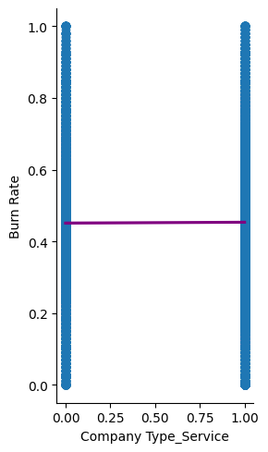
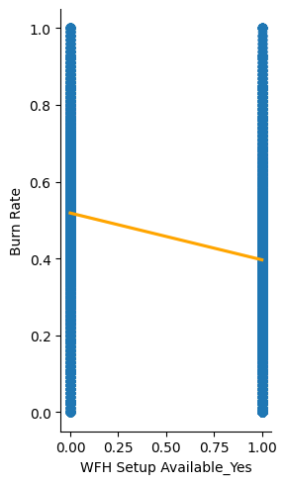
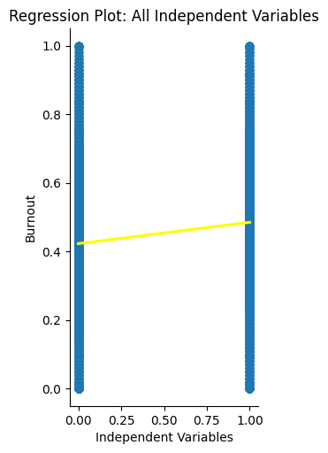
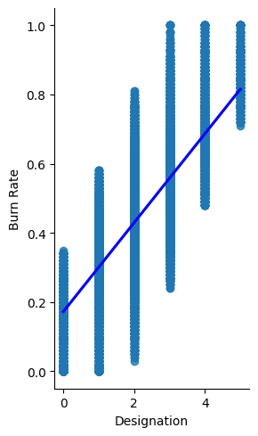
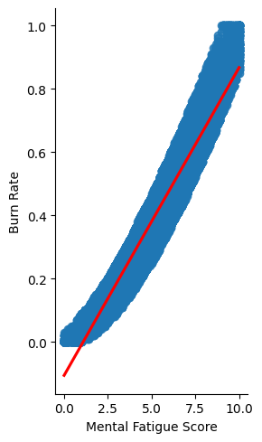
MODELLING : Linear regression

Slide 9
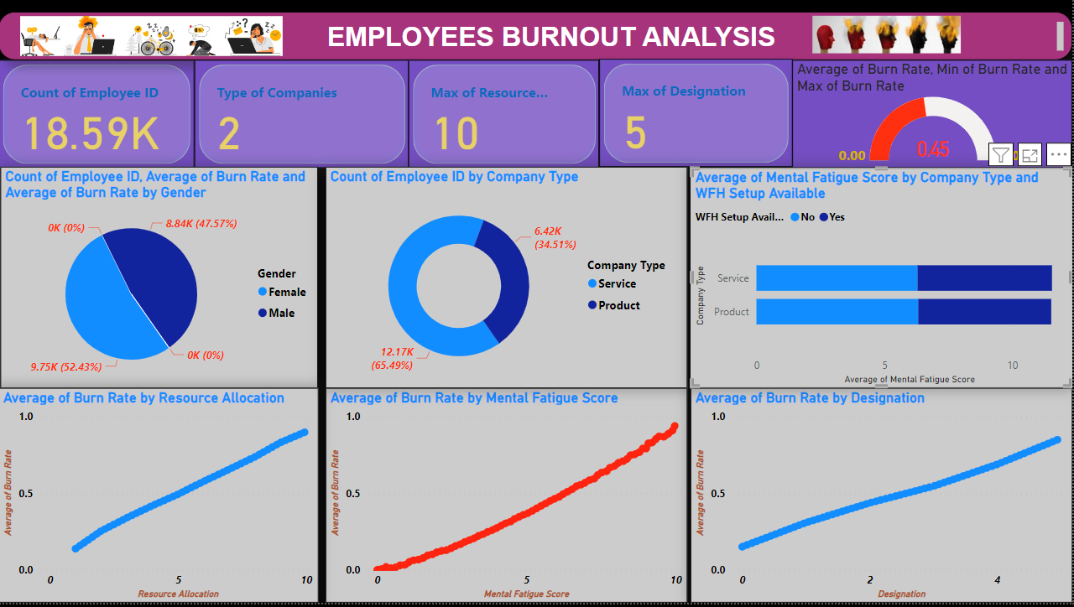
Exploratory Data Analysis (EDA)

Slide 10
Results
Prevalence of burnout
Contributing factors
Intervention strategies
To get more about the project visit this GitHub repository:
https://github.com/Maitreya2004/APSSDC-INTERNSHIP-AI-ML.git

Slide 11
links
This is my GitHub project link:
https://github.com/Maitreya2004/APSSDC-INTERNSHIP-AI-ML.git

